Slide 1
Health For Humanity
- By Selva Kumar, Sourabh Chourey and Amol Talap

Slide 2
Problem - GAPS in Health Care Access
Un-Affordability
Low income groups
Emergency Care
Misuse of Accessibility to 911
Complexity of Health Care
Unawareness of “Affordable Care Act” details
Notes:
Access to Care and Preventive Services; Improve access to care for specific health problems; Determine causes of GAPS in health care accesses
Understand how geographic and social context affects access; Any other solutions you can dream up ( the pathway are endless)

Slide 3
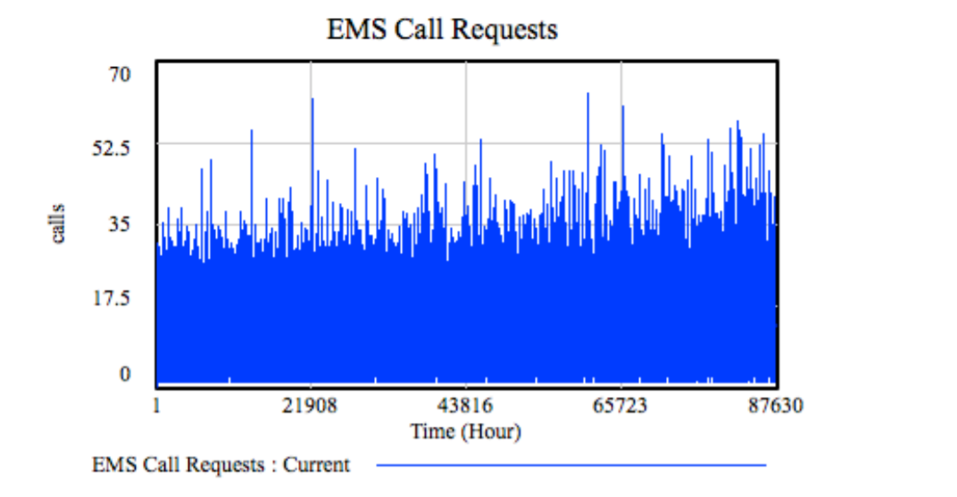
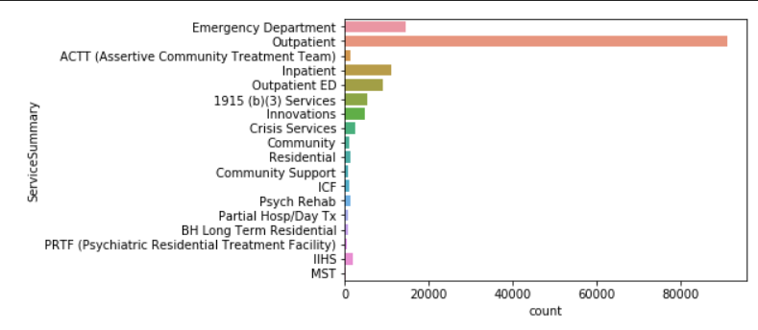
Statistics: Mecklenburg county
911 calls over last 10 yrs
Services
Summary

Slide 4
Solution - GAPS in Health Care Access
Increase preventive care to avoid more emergency visits
Education on Affordable Care Act
Incentive and encouragement for preventive care
YOGA for humanity
Notes:
https://themindedinstitute.com/yoga-in-healthcare/yoga-healthcare-around-the-world/

Slide 5
Conclusion
Prevention is better than cure
MediLink can create a YOGA Mobile App with tracker in built to promote health care
Medilink can provide incentive over preventive action by extending offerings.

